Slide 1

Create proforma pre-payment order including One-Time customer instruction
Version 20230327
Click on the audio symbol

Slide 2
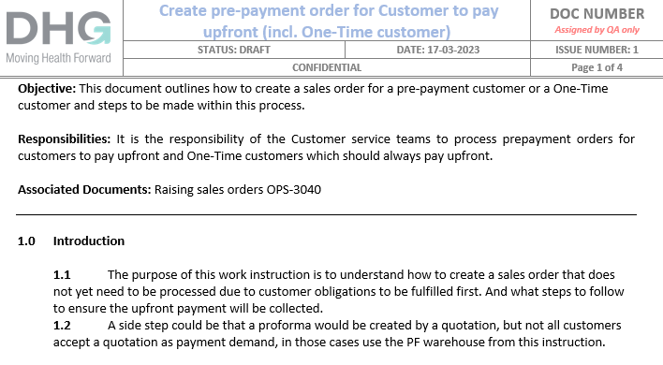
Click on the audio symbol

Slide 3
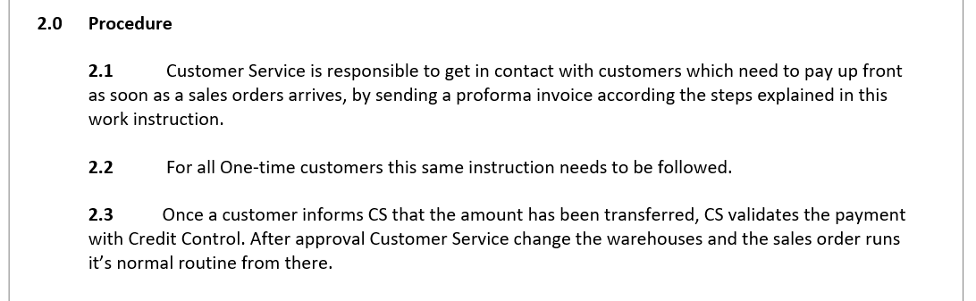
Click on the audio symbol

Slide 4
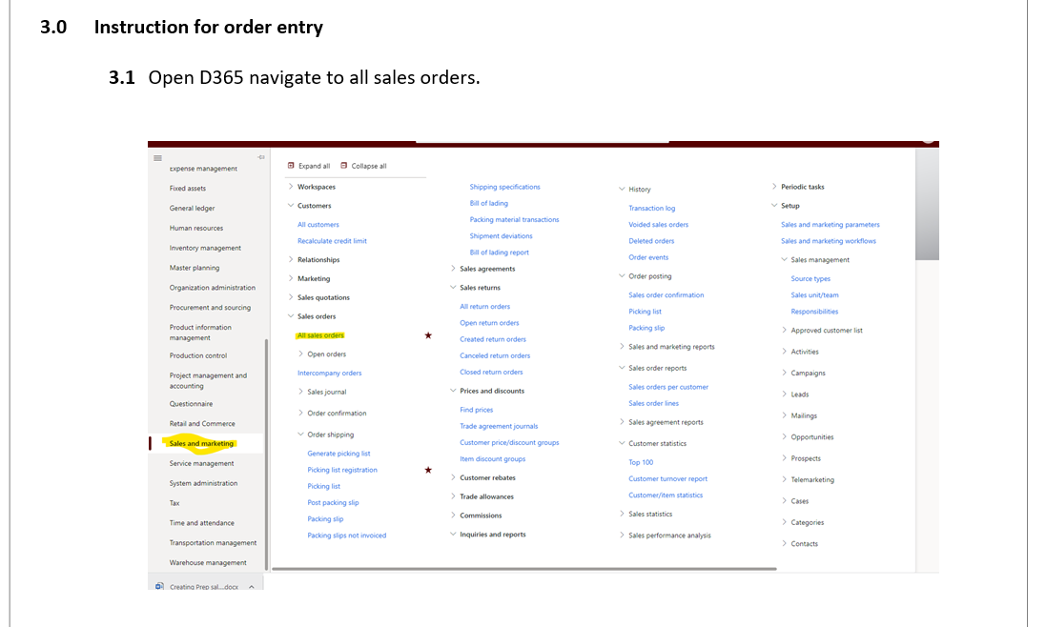
Click on the audio symbol

Slide 5
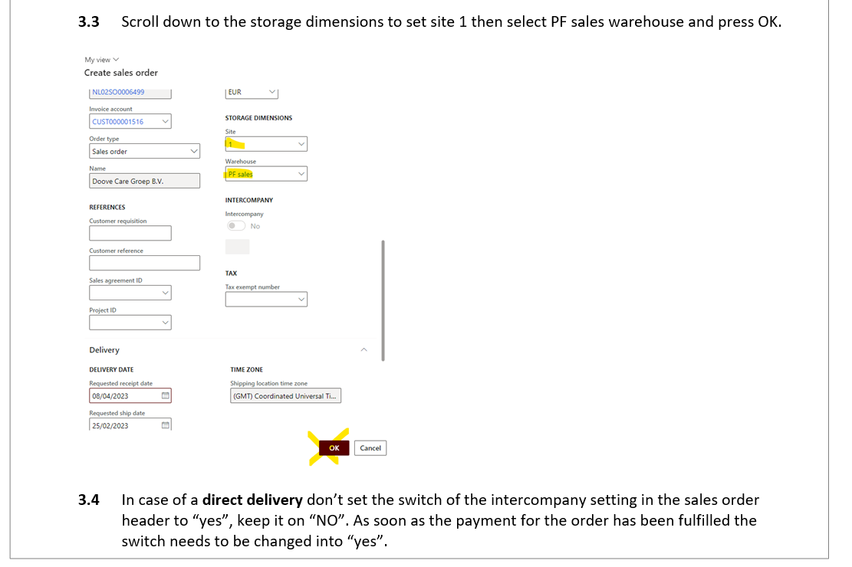
Click on the audio symbol

Slide 6
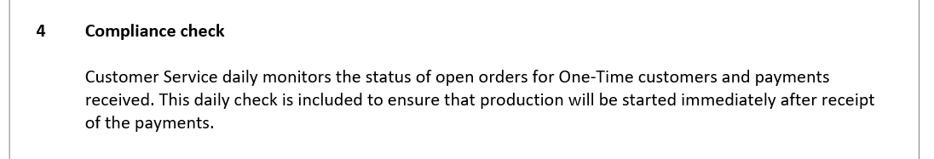
Questions about this instruction can be asked to your local manager or made known in the BMS tracker.
You can find the tracker on the Group Customer Services SharePoint site in the folder “How To’s-working instructions.
Link: https://directhealthcareservices.sharepoint.com/:x:/s/GroupCustomerServices/EZO8t_Q1qvtEg1cNhGsx5OsBwh9_8mHk99d3PSrveG_YvA?e=aa0FCF
Click on the audio symbol

